Slide 1
Introduction to Microsoft Excel 2007 - New Look and Feel
Learningcomputer.com

Slide 2
Where is the File Menu?
Microsoft Office 2007 has replaced the Menu and Standard Toolbar with a new feature called the “Ribbon”
This new interface improves the work flow which translates to a more efficient use of the application
The Ribbon is broken down into Tabs that deal with a specific document action
The Tabs are in turn split into Groups of commands with a more focused functionality
The whole idea is to let the end user be more productive and spend less time looking for icons and commands

Slide 3
Lets go down the list
Office 2007 Button
Ribbon – Split into Tabs and Groups
Rows/Columns/Cells, Name Box, Formula Bar
Quick Access Toolbar + Title Bar
Mini Toolbar and Right Click Menu
Using Keyboard shortcuts
Status Bar
  Workbook View Bar
  Zoom Toolbar

Slide 4
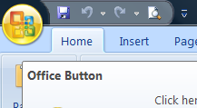
Office 2007 Button
The Office 2007 Button replaces the File menu available in previous versions of Microsoft Office
This provides functionality common to all Office applications like Word, Excel, Outlook etc.
The Office 2007 Button includes commands for opening, saving, printing, and closing a file
Commands are listed on the left side, and recently opened documents appear on the right side
Using Excel Options button, you can customize settings
Let us see it in action!

Slide 5
It’s all about the Ribbon
Microsoft Office 2007 has replaced the Menu and Standard Toolbar with a new feature called “Ribbon”
The Ribbon is designed to help you quickly find the commands that you need to complete a task. This improves the overall workflow in the Microsoft Office Applications
Commands are organized in Groups, which are collected together under Tabs that are specific to a certain action item
To reduce clutter, some tabs are shown only when needed. For example, the Table Tools tab is shown only when a table is selected

Slide 6
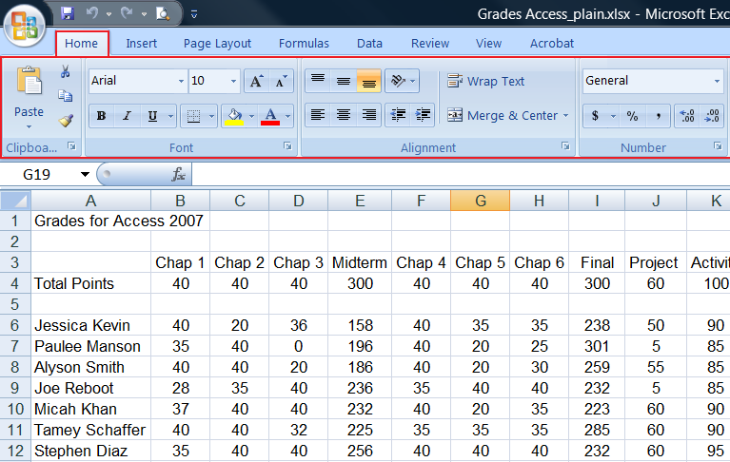
Ribbon

Slide 7
Rows/Columns/Cells, Name Box, Formula Bar
Everything in Excel 2007 is defined by a Cell
Cell is nothing more than a location at the intersection of a row and a column like A1
Cell Range is used when you have more than one cell like B15:K15 highlights the average
Name Box can also highlight your cell location
Formula Bar is an invaluable tool used in function calculations

Slide 8
Quick Access Toolbar + Title Bar
Quick Access Toolbar is a new feature of Microsoft Excel 2007
It lets you access commonly used commands in a similar fashion as the old Standard Toolbar
By default, this toolbar shows Save, Undo, and Redo icons are present
You can easily customize this toolbar, e.g. in our case, it has the Save, Undo, Redo, Print, Spelling and Open commands
Title Bar include information about the current Workbook

Slide 9

Mini Toolbar and Right Click Menu
Mini Toolbar is also a new feature of Microsoft Excel 2007
It combines commands from the Font and Paragraph group available under the Home Tab
Mini Toolbar is a timesaver if you are working on a different tab and have to perform formatting related task
Invoked by using the RMB (right mouse button)
Regular Right Click Menu has a few more options

Slide 10
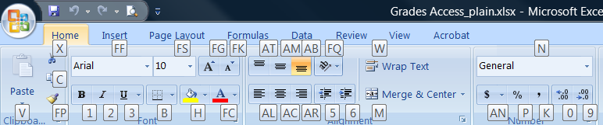
Using Keyboard shortcuts
The Keyboard shortcuts are invoked by Alt Key
Notice under the Home tab, the Keyboard shortcuts are highlighted for the Ribbon
Commands like Ctrl + C, Ctrl + V, Alt + F (surprisingly) still work, however you will have to learn the new Ribbon ones

Slide 11
Status Bar
Status Bar displays some additional information
Let us select a few cells in the Grades Workbook and see what we get
It also has the Document View Bar and Zoom Toolbar
  Workbook View Bar lists all the different layouts that you can view the spreadsheet in
  Zoom Toolbar is handy when you would like to see your spreadsheet from a bird’s eye view
Workbook View Toolbar
Zoom Toolbar

